Slide 1
4CS401
Cryptography and Network Security
By,
Manik K. Chavan
Assistant Professor, CSE Department
Walchand College Of Engineering, Sangli.
manik.chavan@walchandsangli.ac.in
Mob. 7507760777/9545413443

Slide 2
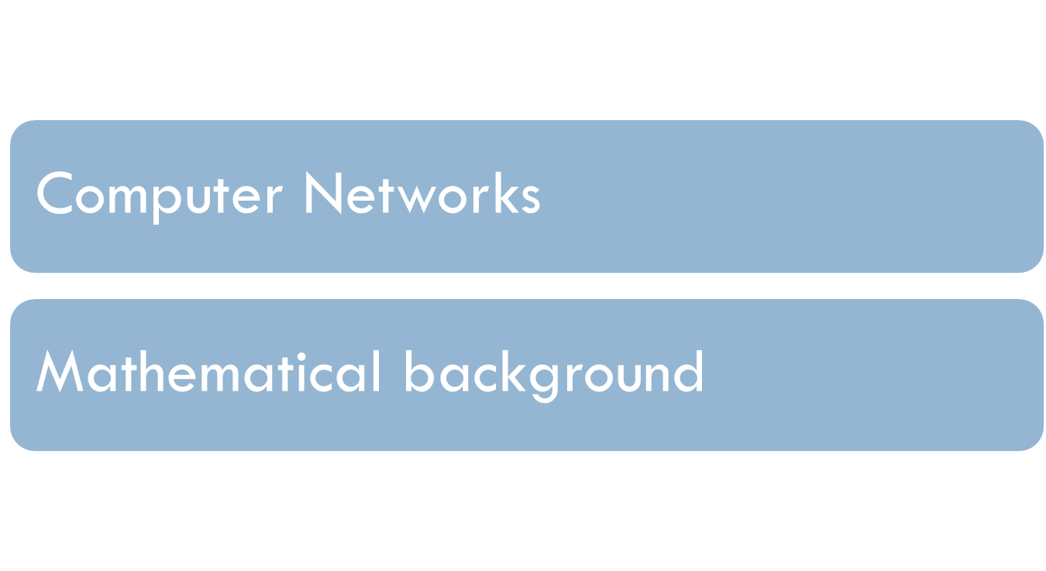
Prerequisite

Slide 3
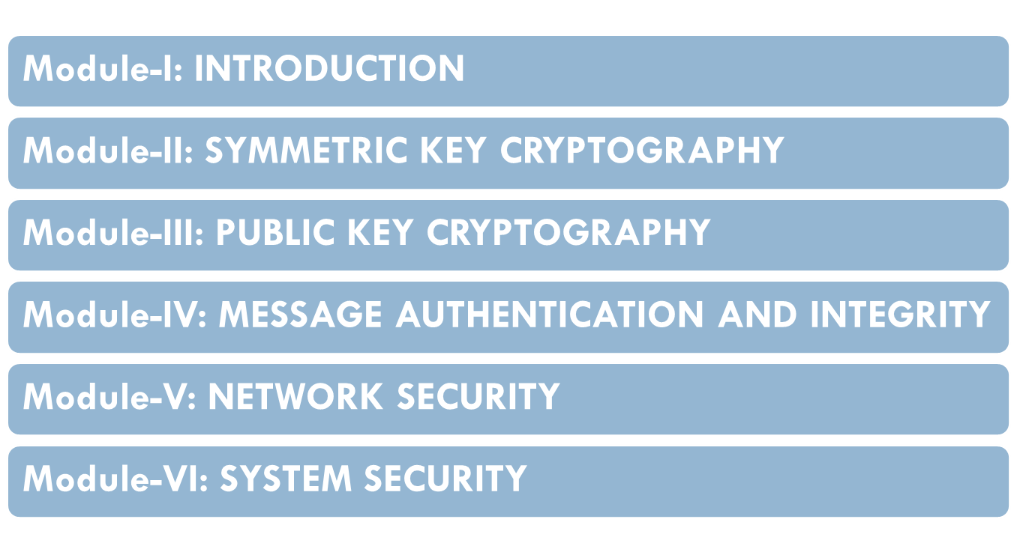
Syllabus

Slide 4
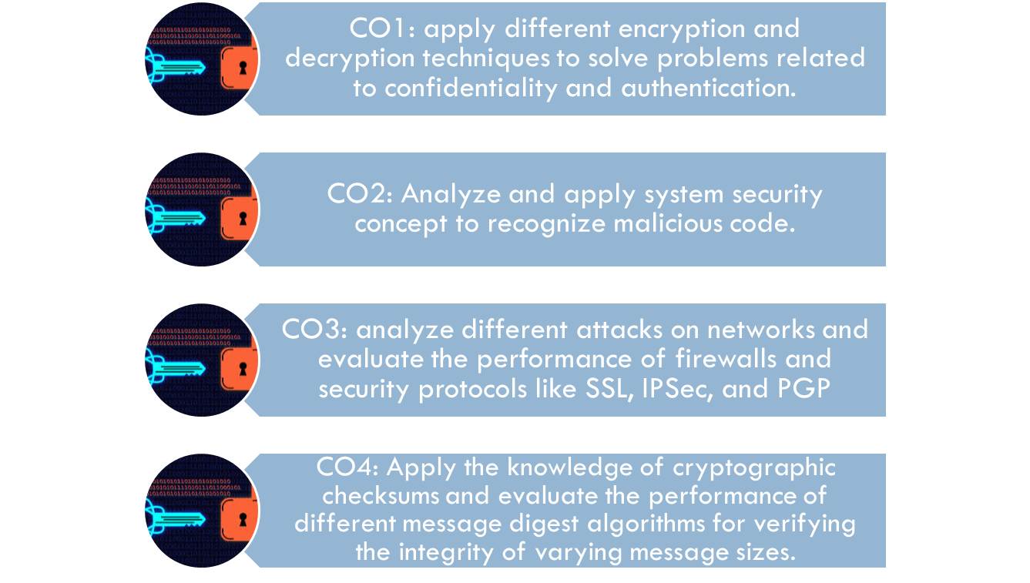
Course Learning Outcomes

Slide 5
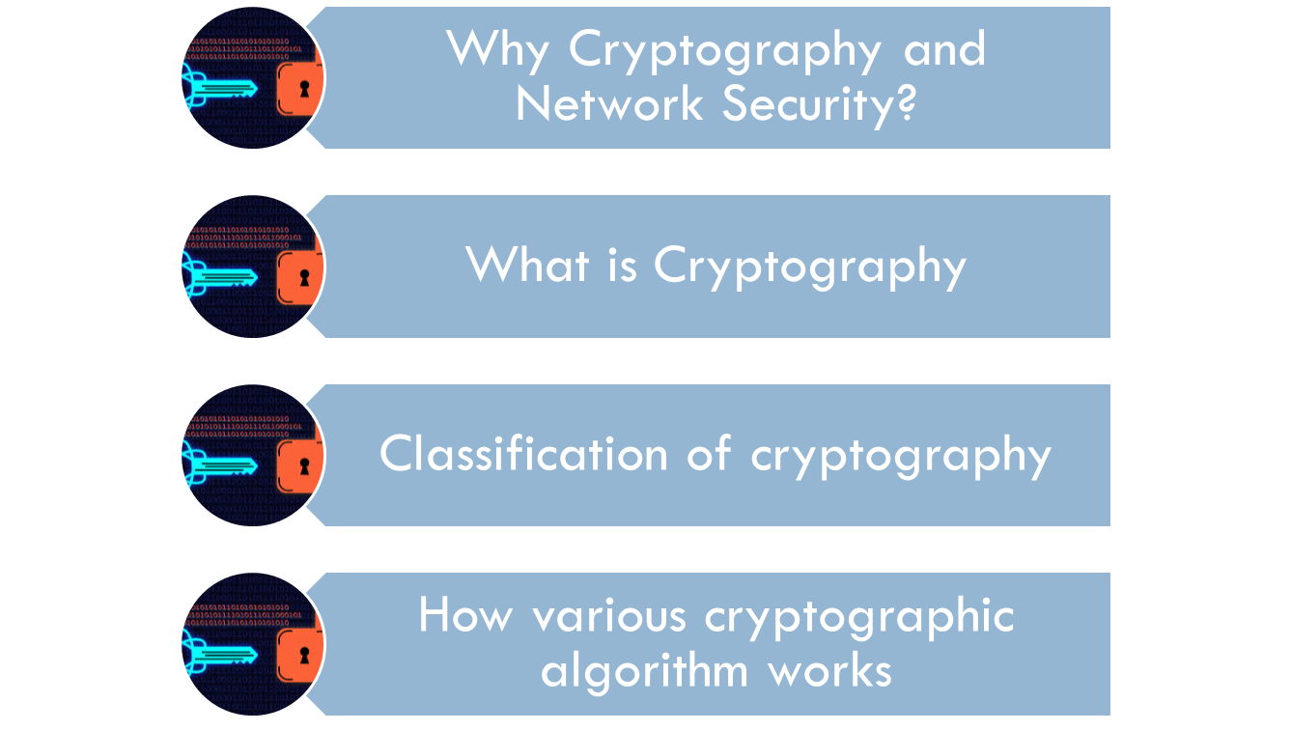
Agenda

Slide 6

Connected world

Slide 7
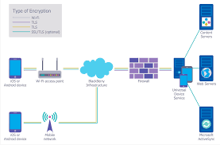
Need for Network Security

Slide 8

Internet stastistics-2020!

Slide 9




Increased Security Breaches

Slide 10
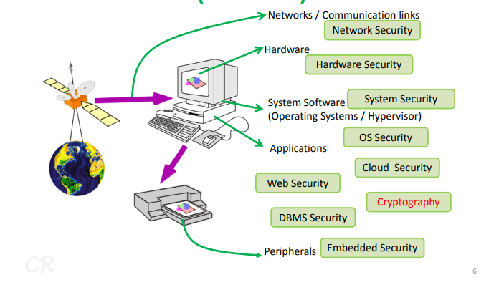
Security Studies(an ocean)

Slide 11
Information Security vs. Cyber Security vs. Network Security
What is Information Security?
  Information security (also known as InfoSec) ensures that both physical and digital data is protected from unauthorized access, use, disclosure, disruption, modification, inspection, recording or destruction.
  Information security differs from cybersecurity in that InfoSec aims to keep data in any form secure, whereas cybersecurity protects only digital data.

Slide 12
Information Security vs. Cyber Security vs. Network Security cont.…
What is Cybersecurity?
  Cybersecurity, is a process or measures taken by organizations or experts to protect devices, computer networks, or data from malicious activities.
  What is Network Security?
  a subset of cybersecurity, aims to protect any data that is being sent through devices in your network to ensure that the information is not changed or intercepted.
  role of network security is to protect the organization’s IT infrastructure from all types of cyber threats.

Slide 13



Communication over the Internet
Friends and enemies: Alice, Bob, Trudy
well-known in network security world
Bob, Alice (lovers!) want to communicate “securely”
Trudy (intruder) may intercept, delete, add messages
Alice
Bob
channel
data, control Messages
Sender
Receiver
data
data
Trudy

Slide 14
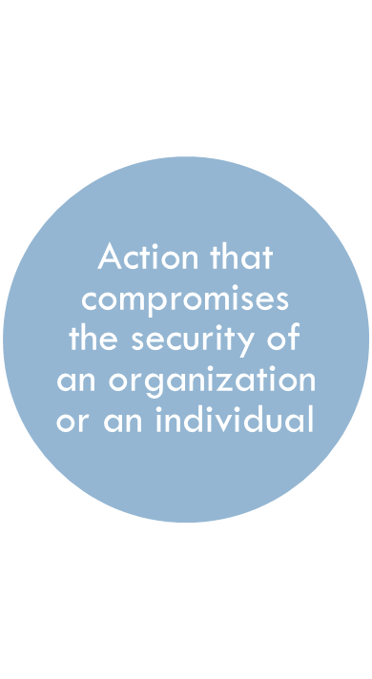
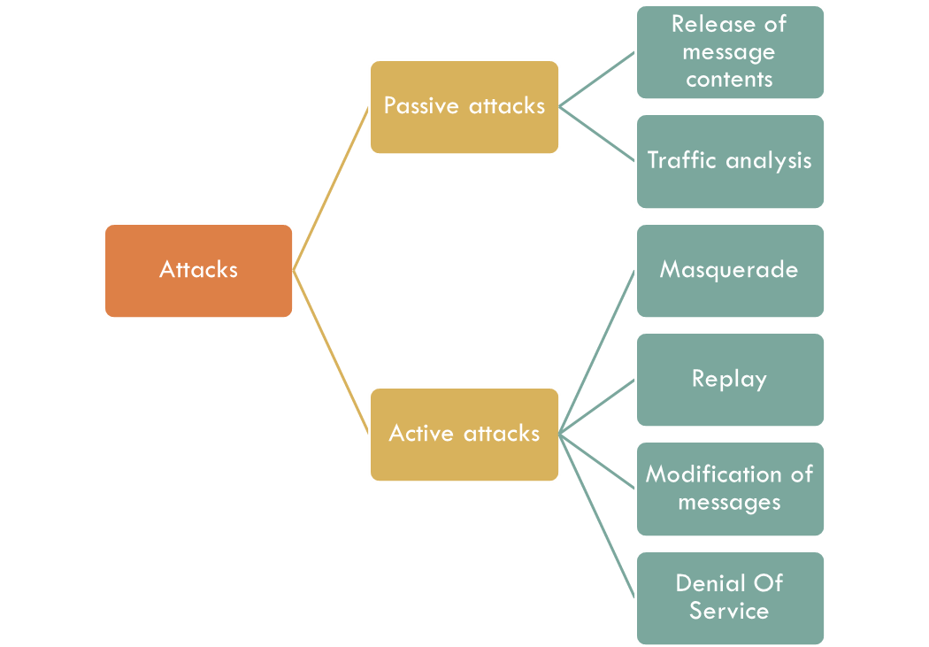
Security attacks

Slide 15
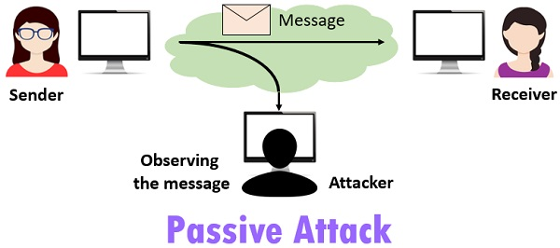
Passive Attacks
Notes:
A useful means of classifying security attacks, used both in X.800 and RFC 2828, is in terms of passive attacks and active attacks. A passive attack attempts to learn or make use of information from the system but does not affect system resources.
Passive attacks are in the nature of eavesdropping on, or monitoring of, transmissions. The goal of the opponent is to obtain information that is being transmitted. Two types of passive attacks are:
+ release of message contents - as shown above in Stallings Figure 1.2a here
+ traffic analysis - monitor traffic flow to determine location and identity of communicating hosts and could observe the frequency and length of messages being exchanged
These attacks are difficult to detect because they do not involve any alteration of the data.

Slide 16
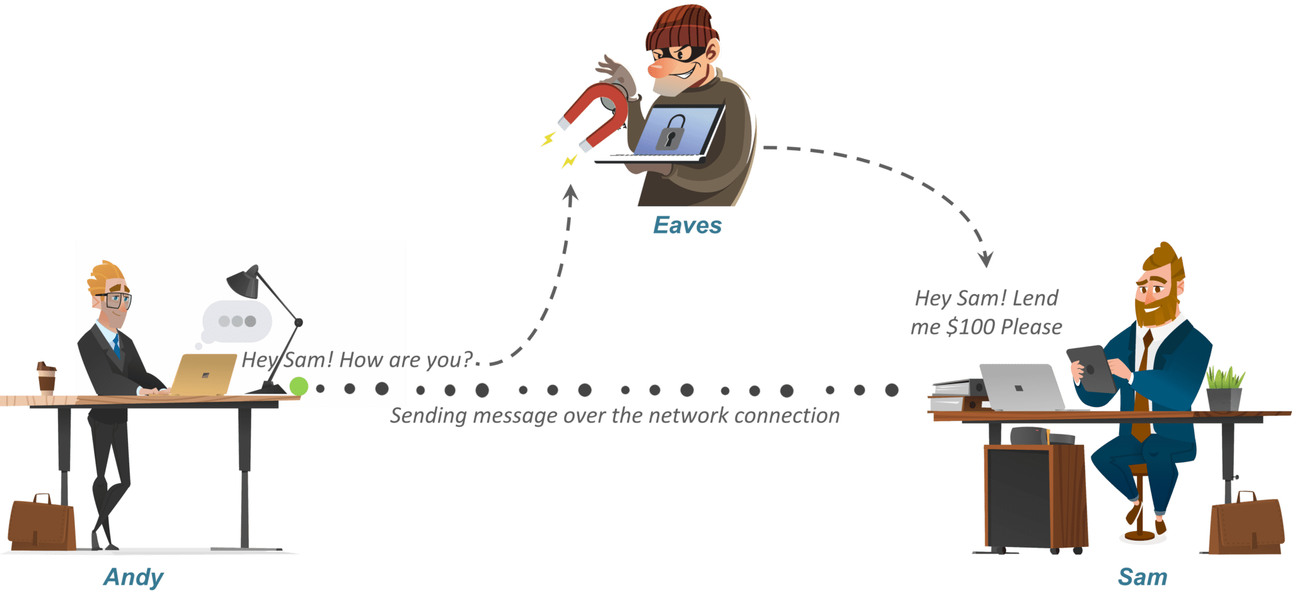
Active attack

Slide 17
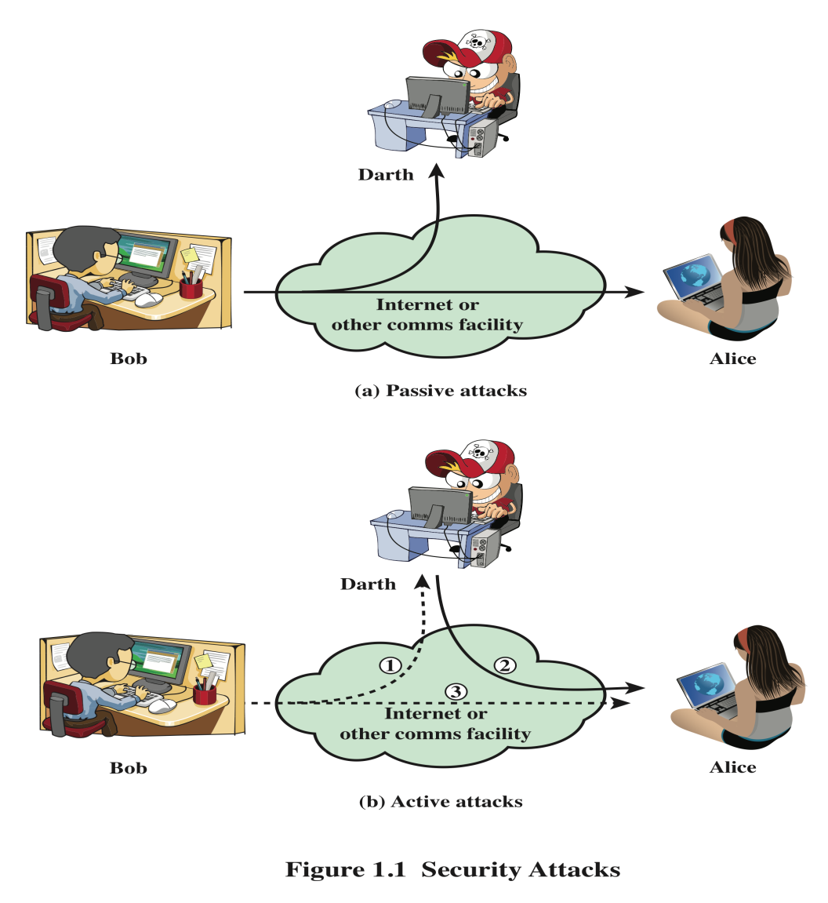
Security Attacks
A means of classifying security attacks, used both in X.800 and RFC 4949, is in terms of passive attacks and active attacks
A passive attack attempts to
learn or make use of
information from the system
but does not affect system
resources
An active attack attempts to
alter system resources or
affect their operation
Notes:
A useful means of classifying security attacks, used both in X.800 and RFC 4949, is in
terms of passive attacks and active attacks (Figure 1.1). A passive attack attempts to
learn or make use of information from the system but does not affect system resources.
An active attack attempts to alter system resources or affect their operation.

Slide 18

Passive Attacks
the nature of eavesdropping on, or monitoring of, transmissions
Goal of the opponent is to obtain information that is being transmitted
Two types of passive attacks are:
  The release of message contents
  Traffic analysis
Notes:
Passive attacks (Figure 1.1) are in the nature of eavesdropping on, or monitoring
of, transmissions. The goal of the opponent is to obtain information that is being
transmitted. Two types of passive attacks are the release of message contents and
traffic analysis.
The release of message contents is easily understood. A telephone conversation,
an electronic mail message, and a transferred file may contain sensitive or
confidential information. We would like to prevent an opponent from learning the
contents of these transmissions.
A second type of passive attack, traffic analysis , is subtler. Suppose that we
had a way of masking the contents of messages or other information traffic so that
opponents, even if they captured the message, could not extract the information
from the message. The common technique for masking contents is encryption. If we
had encryption protection in place, an opponent might still be able to observe the
pattern of these messages. The opponent could determine the location and identity
of communicating hosts and could observe the frequency and length of messages
being exchanged. This information might be useful in guessing the nature of the
communication that was taking place.
Passive attacks are very difficult to detect, because they do not involve any
alteration of the data. Typically, the message traffic is sent and received in an apparently
normal fashion, and neither the sender nor receiver is aware that a third party
has read the messages or observed the traffic pattern. However, it is feasible to prevent
the success of these attacks, usually by means of encryption. Thus, the emphasis
in dealing with passive attacks is on prevention rather than detection.

Slide 19
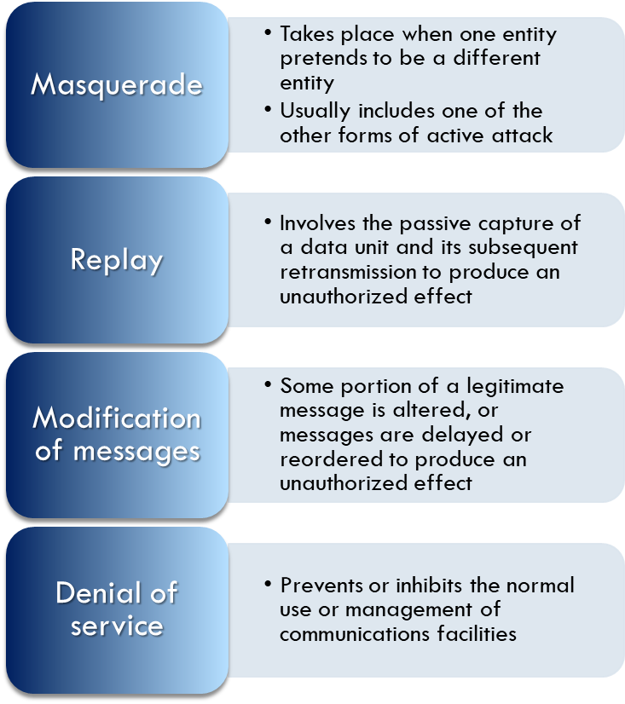

Active Attacks
Involve some modification of the data stream or the creation of a false stream
Difficult to prevent because of the wide variety of potential physical, software, and network vulnerabilities
Goal is to detect attacks and to recover from any disruption or delays caused by them
Notes:
Active attacks (Figure 1.1b) involve some modification of the data stream or the
creation of a false stream and can be subdivided into four categories: masquerade,
replay, modification of messages, and denial of service.
A masquerade takes place when one entity pretends to be a different entity
(path 2 of Figure 1.1b is active). A masquerade attack usually includes one of the
other forms of active attack. For example, authentication sequences can be captured
and replayed after a valid authentication sequence has taken place, thus enabling an
authorized entity with few privileges to obtain extra privileges by impersonating an
entity that has those privileges.
Replay involves the passive capture of a data unit and its subsequent retransmission
to produce an unauthorized effect (paths 1, 2, and 3 active).
Modification of messages simply means that some portion of a legitimate
message is altered, or that messages are delayed or reordered, to produce an
unauthorized effect (paths 1 and 2 active). For example, a message meaning “Allow
John Smith to read confidential file accounts ” is modified to mean “Allow Fred
Brown to read confidential file accounts. ”
The denial of service prevents or inhibits the normal use or management of
communications facilities (path 3 active). This attack may have a specific target; for
example, an entity may suppress all messages directed to a particular destination
(e.g., the security audit service). Another form of service denial is the disruption
of an entire network, either by disabling the network or by overloading it with
messages so as to degrade performance.
Active attacks present the opposite characteristics of passive attacks. Whereas
passive attacks are difficult to detect, measures are available to prevent their success.
On the other hand, it is quite difficult to prevent active attacks absolutely
because of the wide variety of potential physical, software, and network vulnerabilities.
Instead, the goal is to detect active attacks and to recover from any disruption
or delays caused by them. If the detection has a deterrent effect, it may also
contribute to prevention.

Slide 20
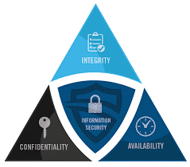
Security goals-CIA Triad
Crucial component in all security system: CIA triad
Cryptography used to achieve:
  Confidentiality
  Only authorized users access information
  Integrity
  Ensure completeness, accuracy
  and an absence of unauthorized
  modifications
  Availability
  Available and operational when required by any authorized users

Slide 21
need to define some other security objectives!
Authentication - a mechanism (a protocol) by which a user is identified and uses some token to prove who they are.
Non-repudiation- a way to guarantee that the sender of a message cannot later deny having sent the message and that the recipient cannot deny having received the message.

Slide 22
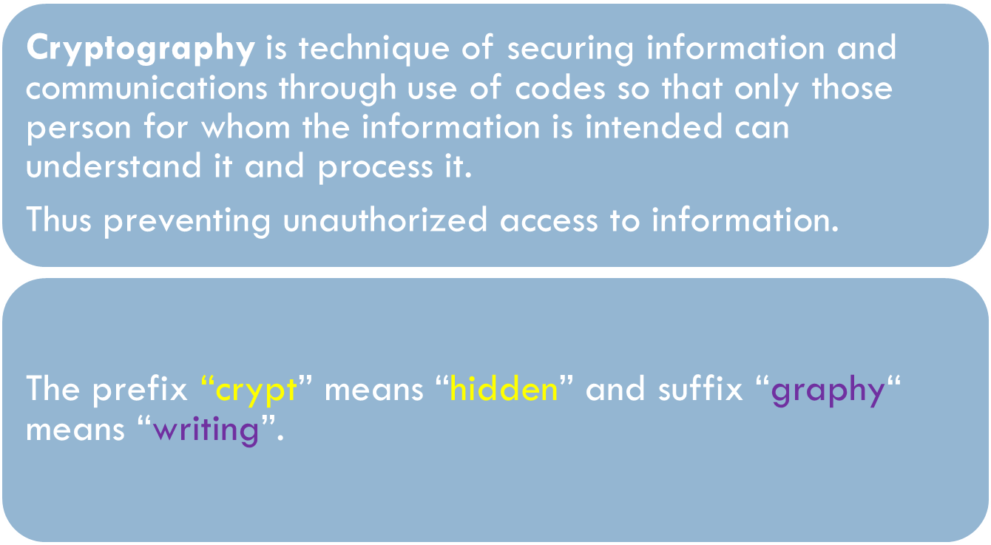
Cryptography

Slide 23
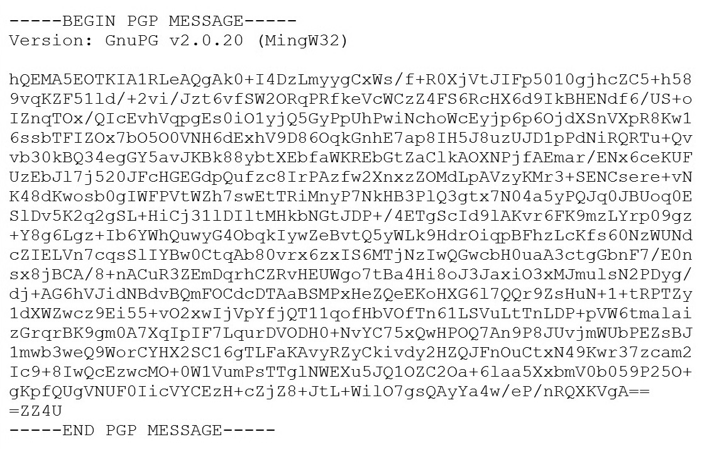
Sample Encrypted Message

Slide 24
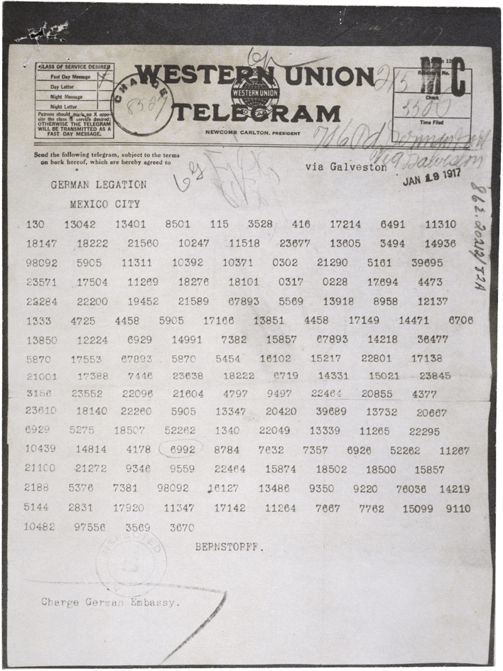
German Telegram

Slide 25

The language of cryptography
Alice’s
encryption
key
Bob’s
decryption
key
K
K
A
B
plaintext
encryption
algorithm
ciphertext
decryption
algorithm
plaintext

Slide 26
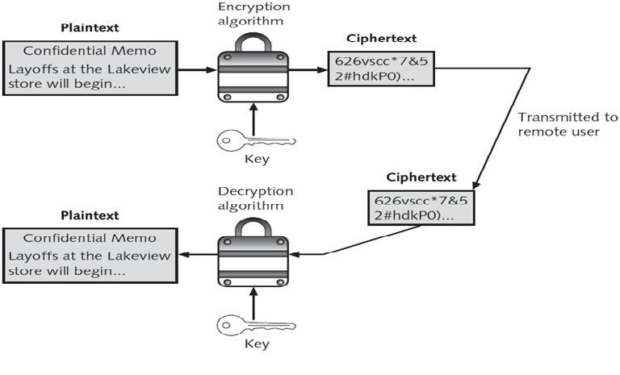
Cryptographic process

Slide 27
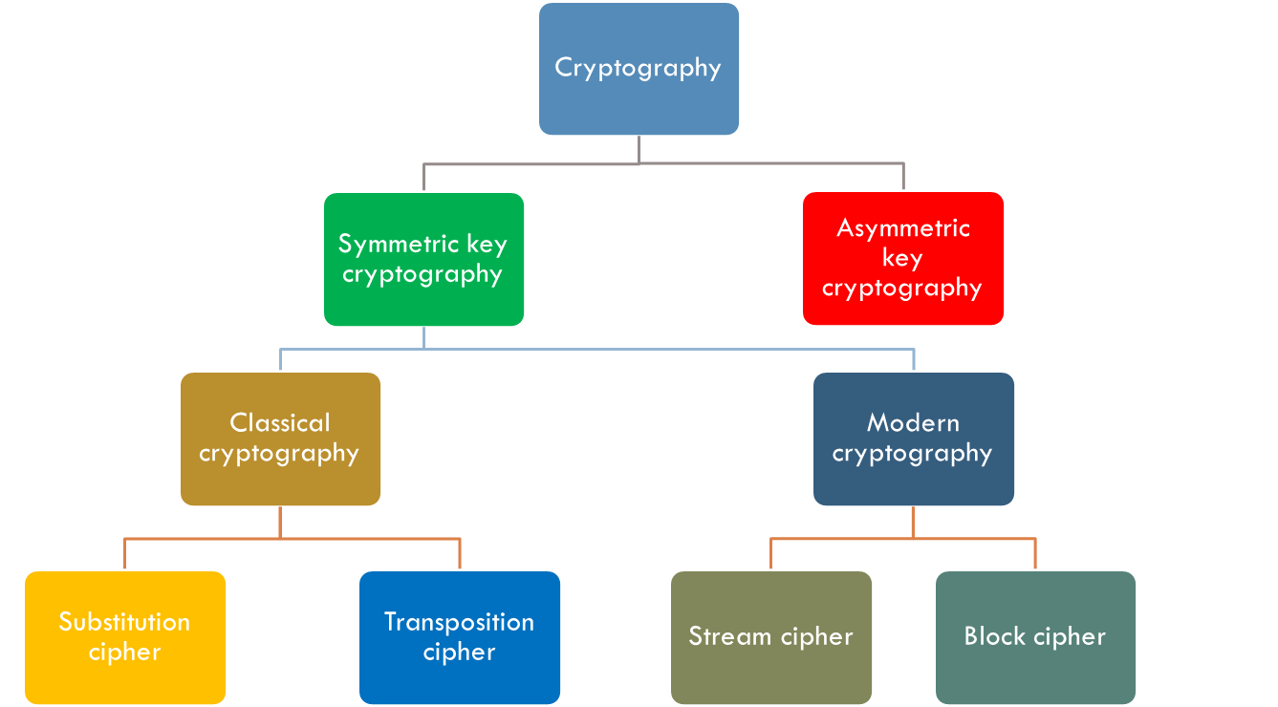
Classification of Cryptography

Slide 28
Types of Cryptography
Crypto often uses keys:
  Algorithm is known to everyone
  Only “keys” are secret
Symmetric key cryptography
  Involves the use one key
Asymmetric key/Public key cryptography
  Involves the use of two keys

Slide 29
Symmetric key cryptography
K
K
S
S
plaintext
message, m
encryption
algorithm
ciphertext
decryption
algorithm
plaintext
K (m)
m = K_{S}(K_{S}(m))
S
symmetric key crypto: Bob and Alice share same (symmetric) key: K
The most common symmetric key system is the Data Encryption Standard (DES)
S

Slide 30
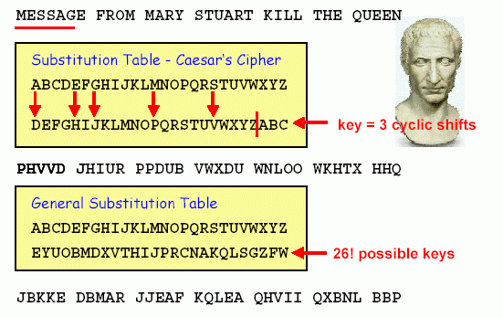
Substitution Cipher: Caesar Cipher
Courtesy:
Andreas
Steffen
Modern substitution ciphers take in N bits and substitute N bits using lookup table: called S-Box

Slide 31
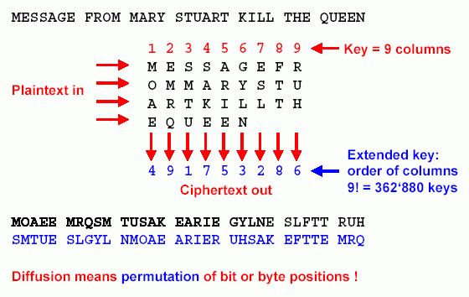
Transposition cipher
Courtesy:
Andreas
Steffen
Modern Transposition ciphers take in N bits and permute using lookup table : called P-Boxes

Slide 32
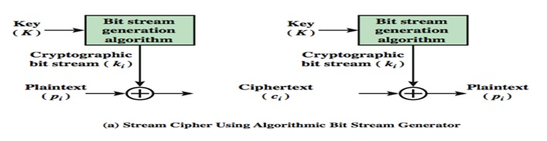
Stream Cipher
Combine each bit of keystream with bit of plaintext to get bit of ciphertext
  c(i) = ks(i) ⊕ m(i)
  m(i) = ks(i) ⊕ c(i)
keystream

Slide 33
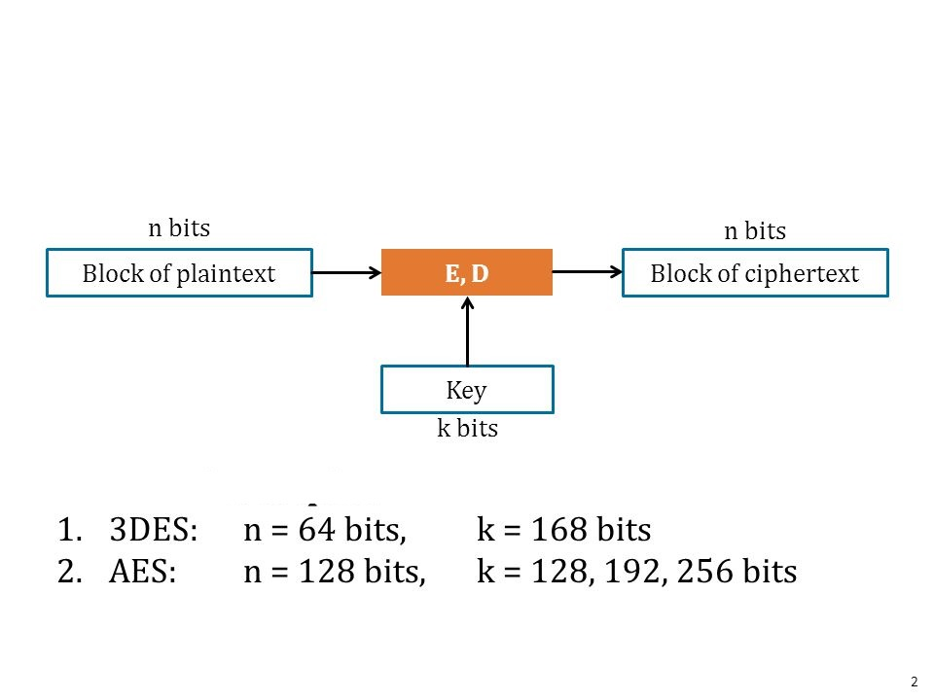
Block ciphers
Message to be encrypted is processed in blocks of k bits (e.g., 64-bit blocks).
input output
000 110
001 111
010 101
011 100
input output
100 011
101 010
110 000
111 001

Slide 34
Thank You…
Any queries…?
manik.chavan@walchandsangli.ac.in
Contact No. 7507760777

